Slide 1
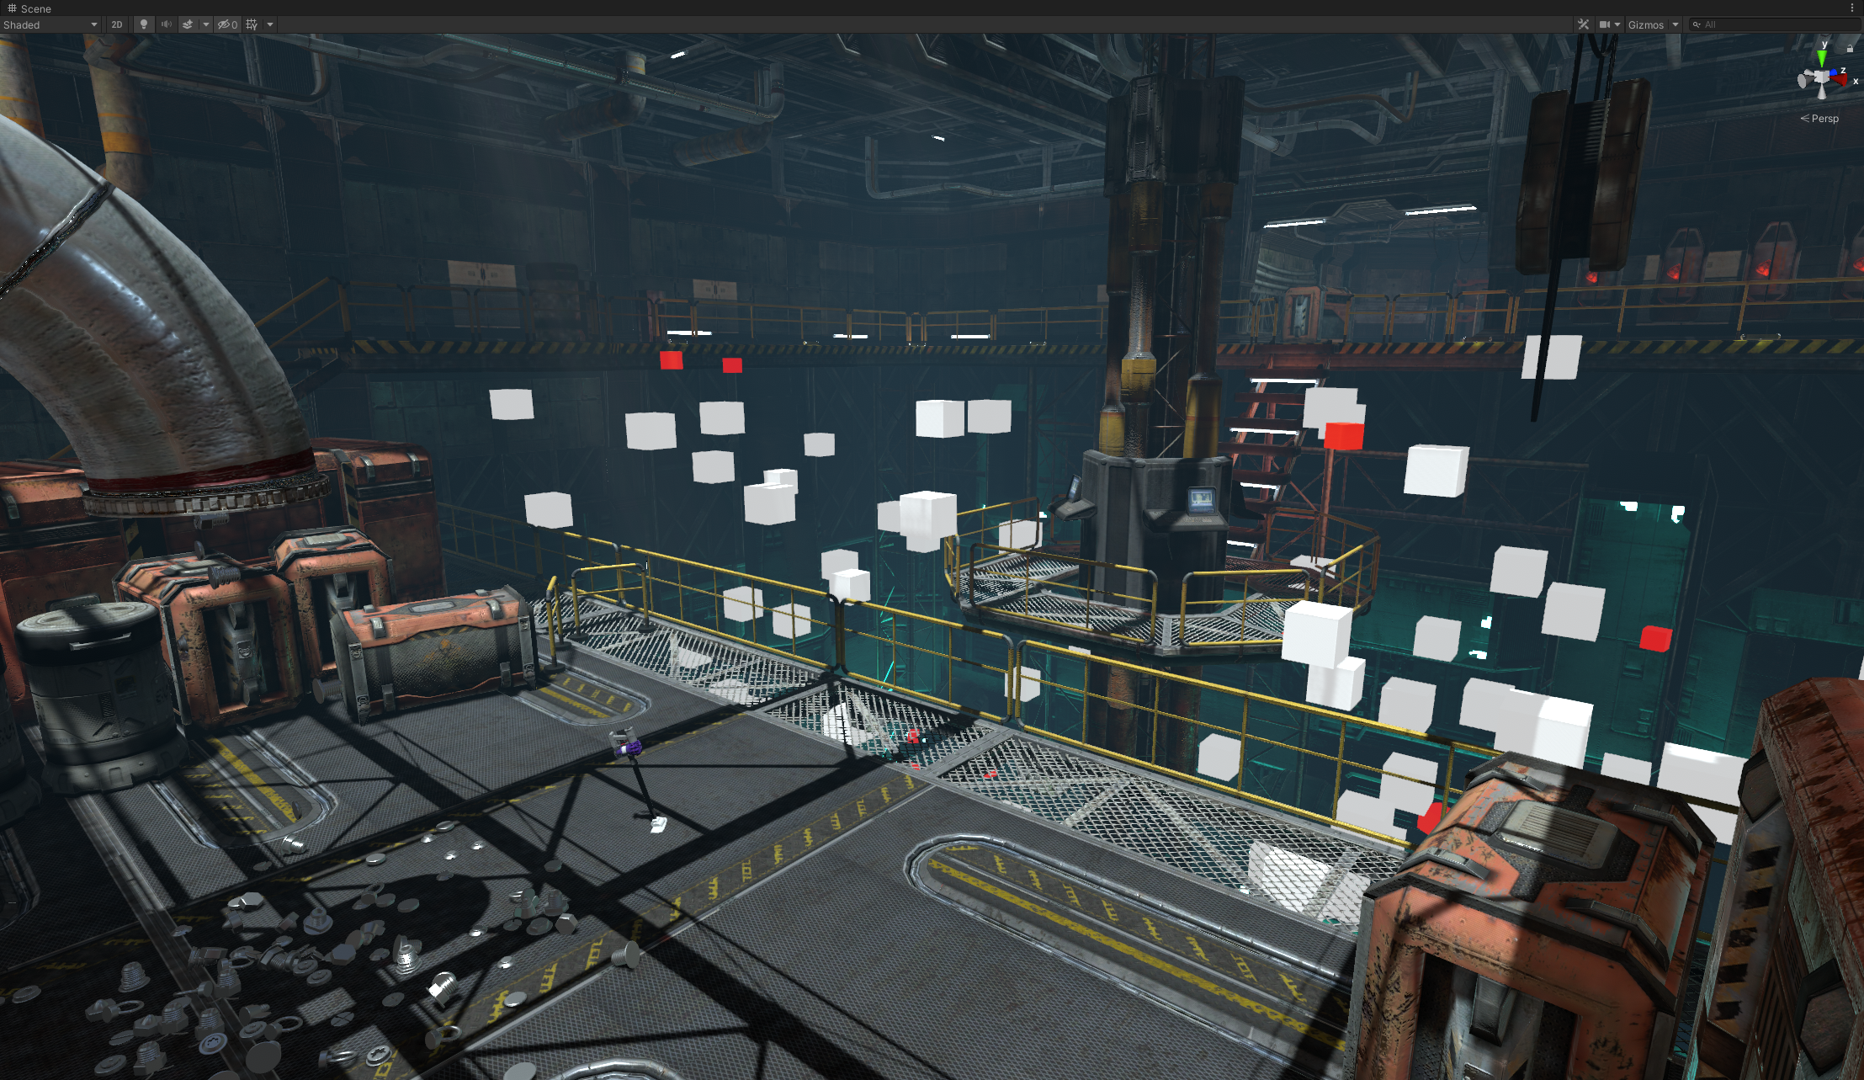
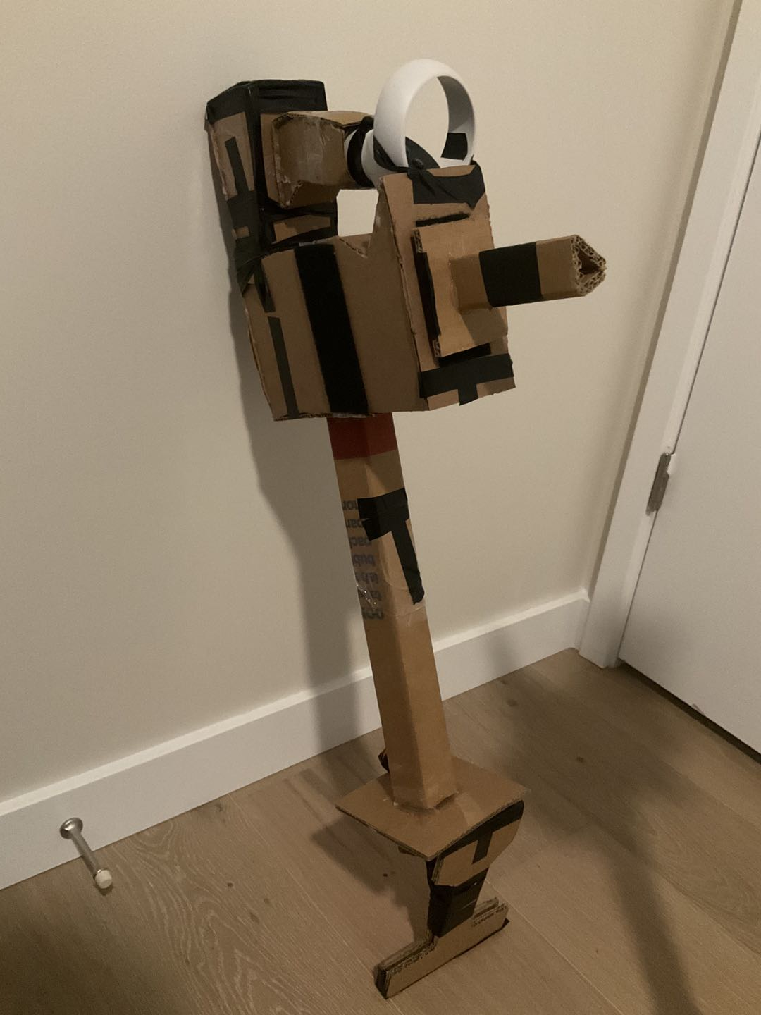
VACUUM WAR

Slide 2
Credits
Junce Wang
PRODUCER, DESIGNER, TECH ARTIST & ENGINEER
Zeshi Chen
HARDWARE DESIGNER & TECH ARTIST
Lei Zhao
HARDWARE ENGINEER
Kaisen Xue
ARTIST
Tejas Ved
ENGINEER
Ben Crosby
AUDIO DESIGNER & CO-PRODUCER

Slide 3
Vacuum War
Alternative Controller: Vacuum gun
Genera: Arcade shooter game (Prototype only)
Platform: Virtual Reality (PC), Oculus Quest 2 (all-in-one) in the future
Engine: Unity with OpenXR plug-in

Slide 4
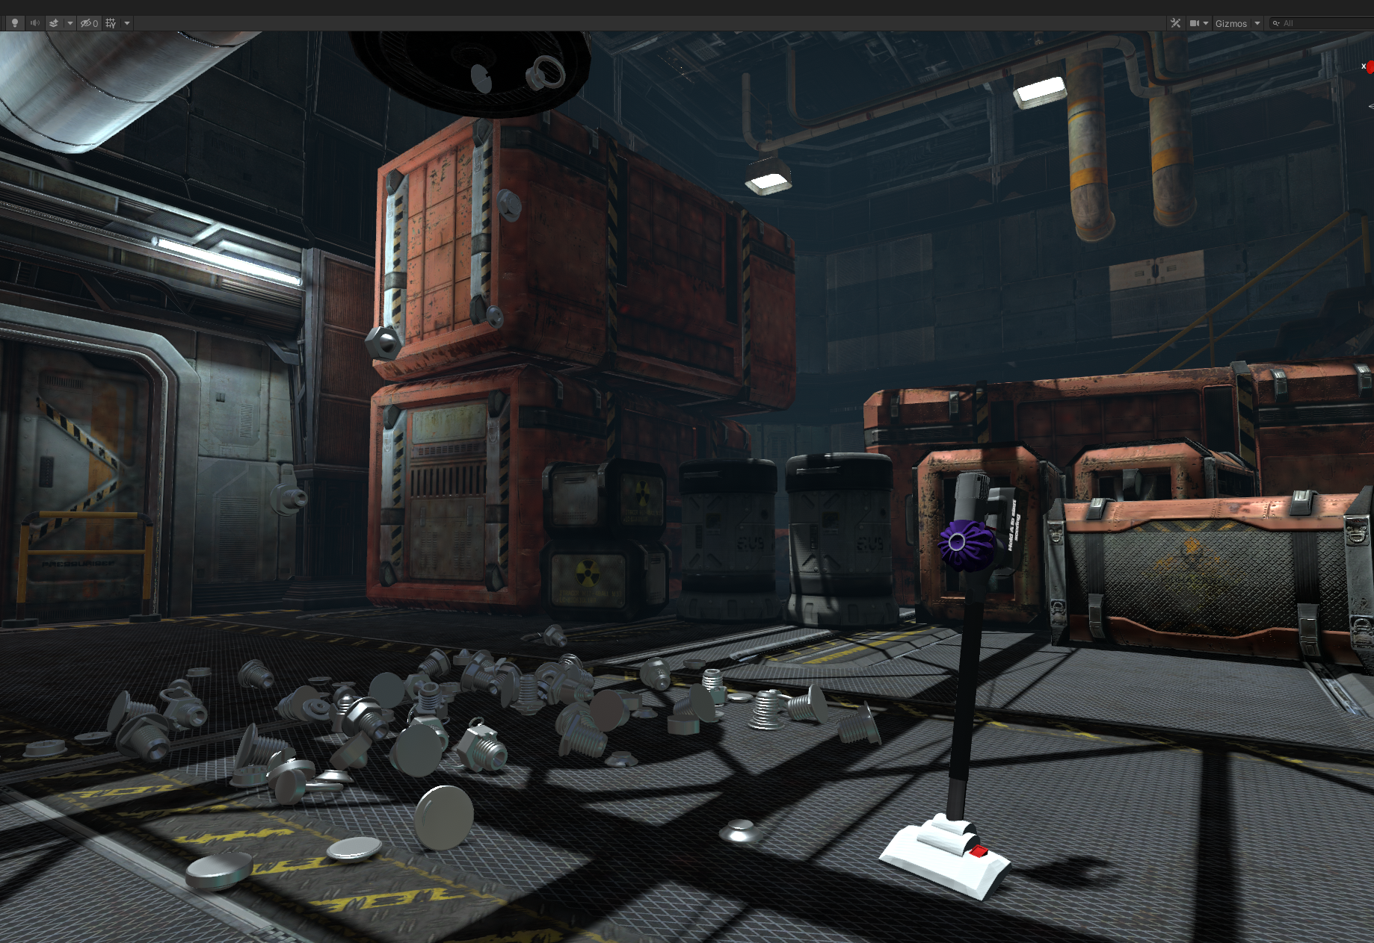
DEMOSTRATION

Slide 5
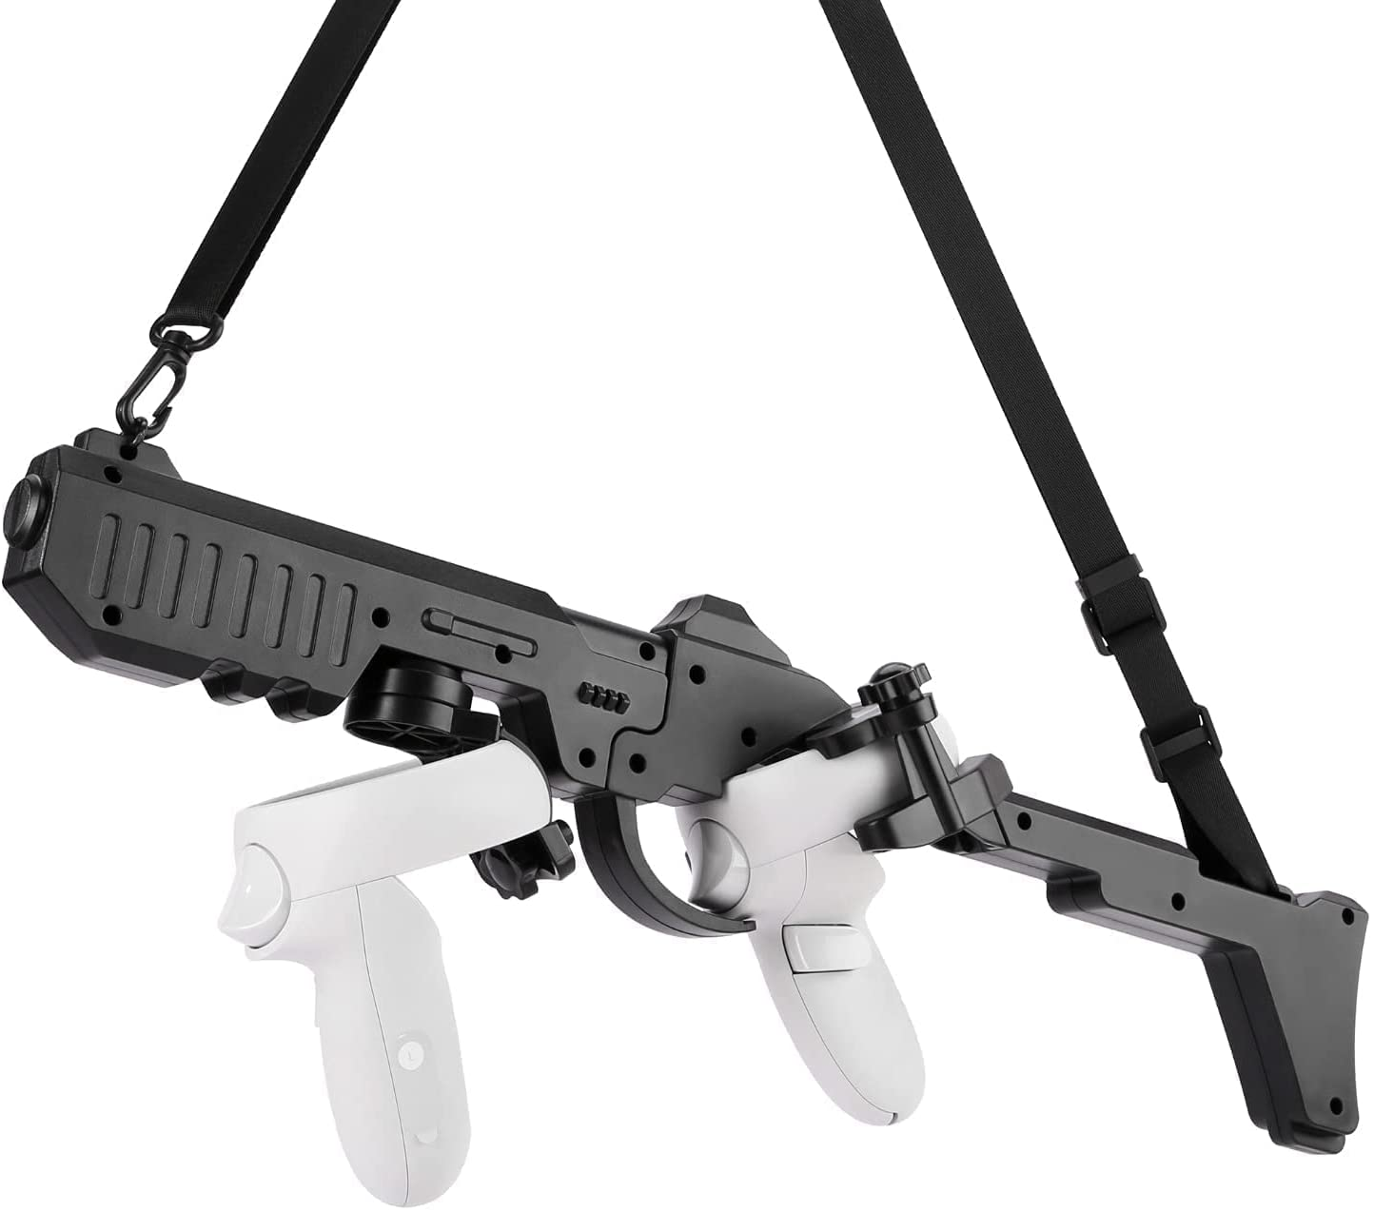
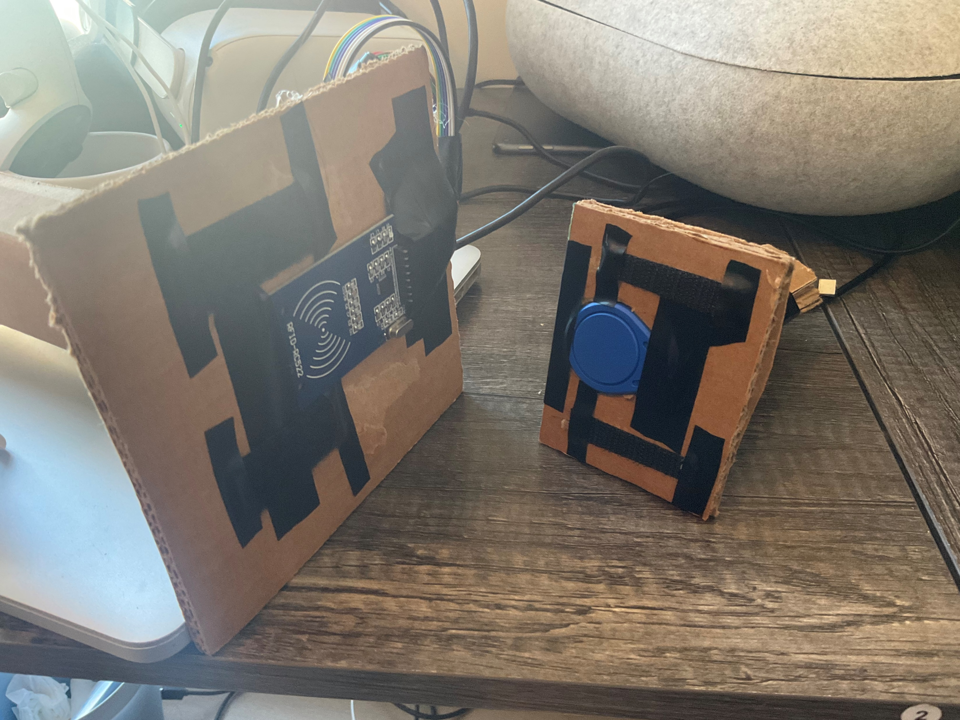
R & D
Tracking:
VR 6-DOF controller
Attachment:
RFID + Velcro

Slide 6
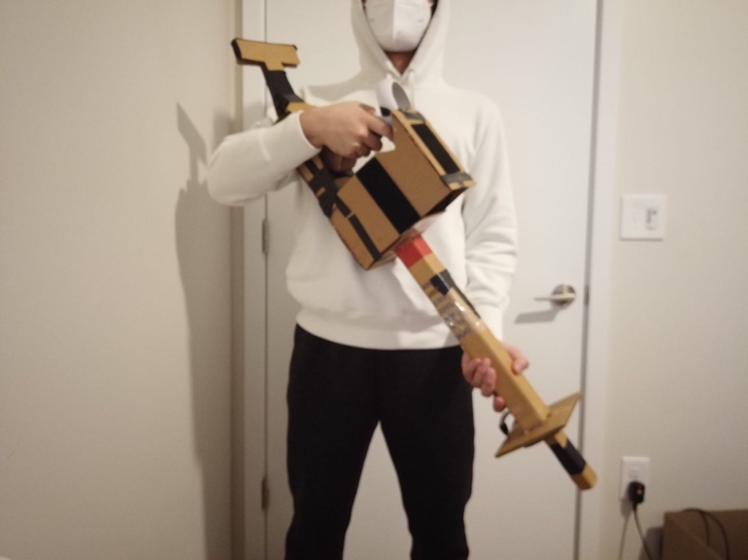
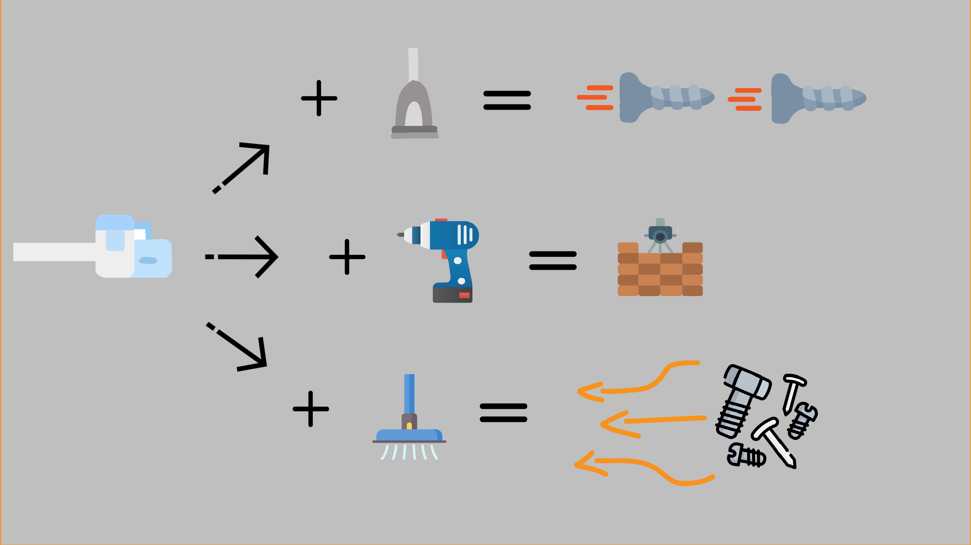
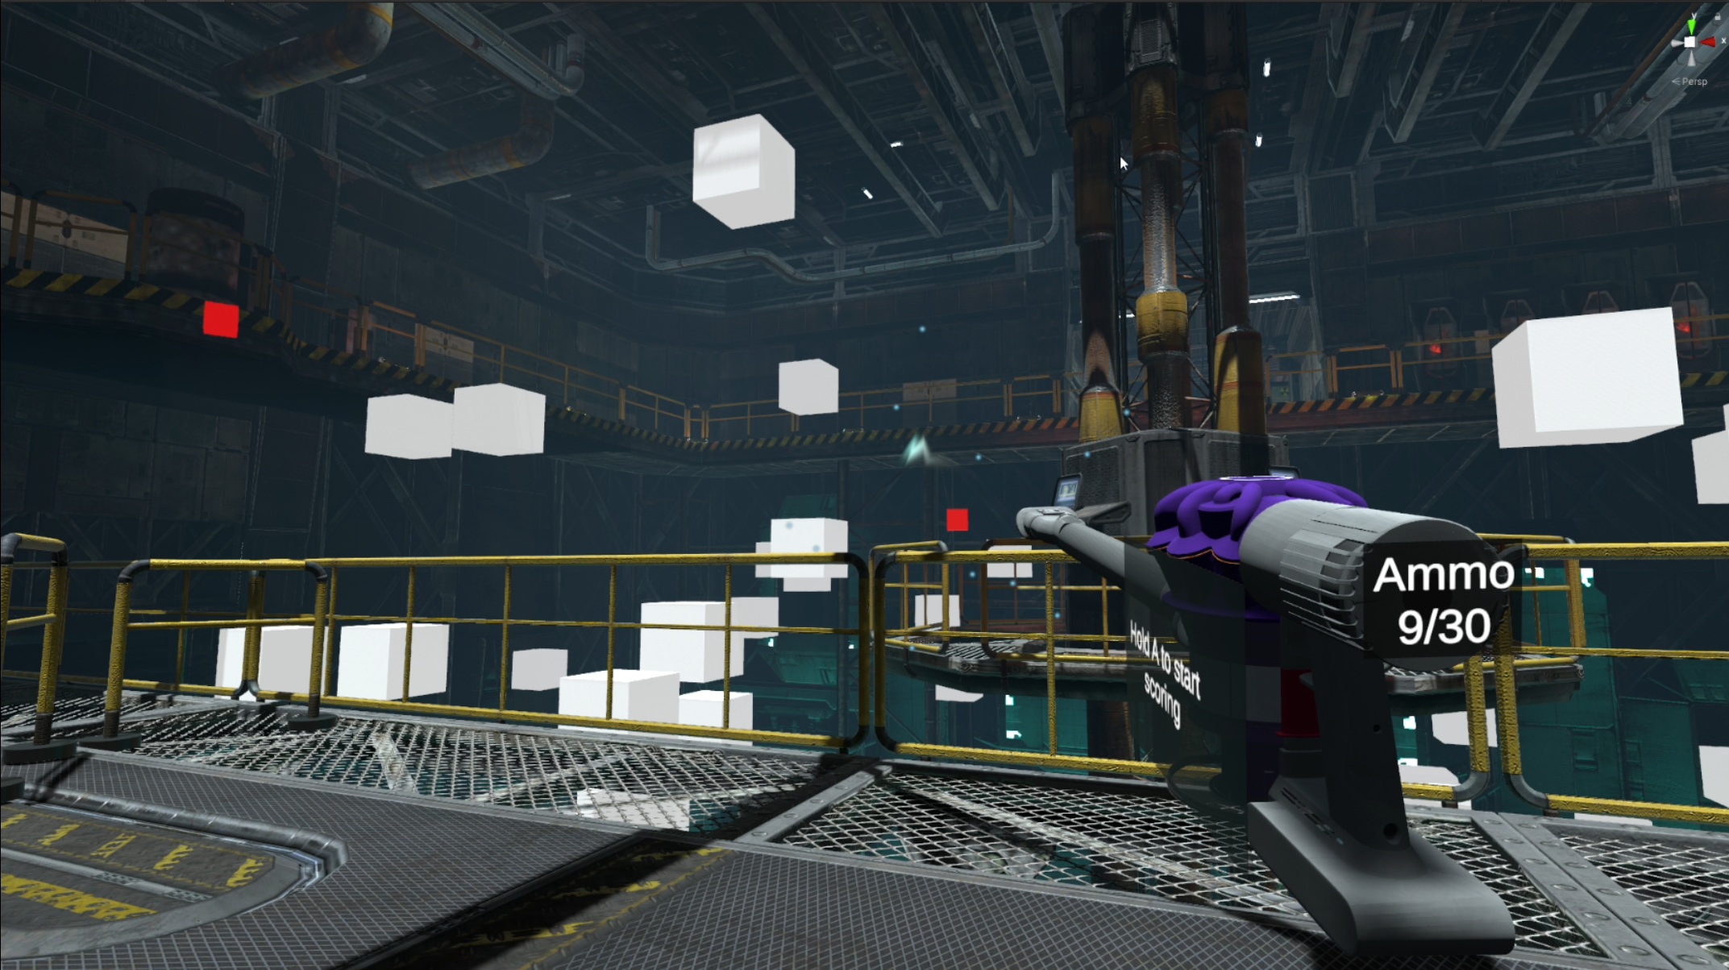
DESIGN PILLARS
Make-believe
Multifunctional Tool
Notes:
Make-believe: Fill the gap between imagination and reality. With a sweep you can image you’re fly. With a clog you can image that’s your sword. VR.
Multifunctional tool: Playability as a controller. RFID.

Slide 7
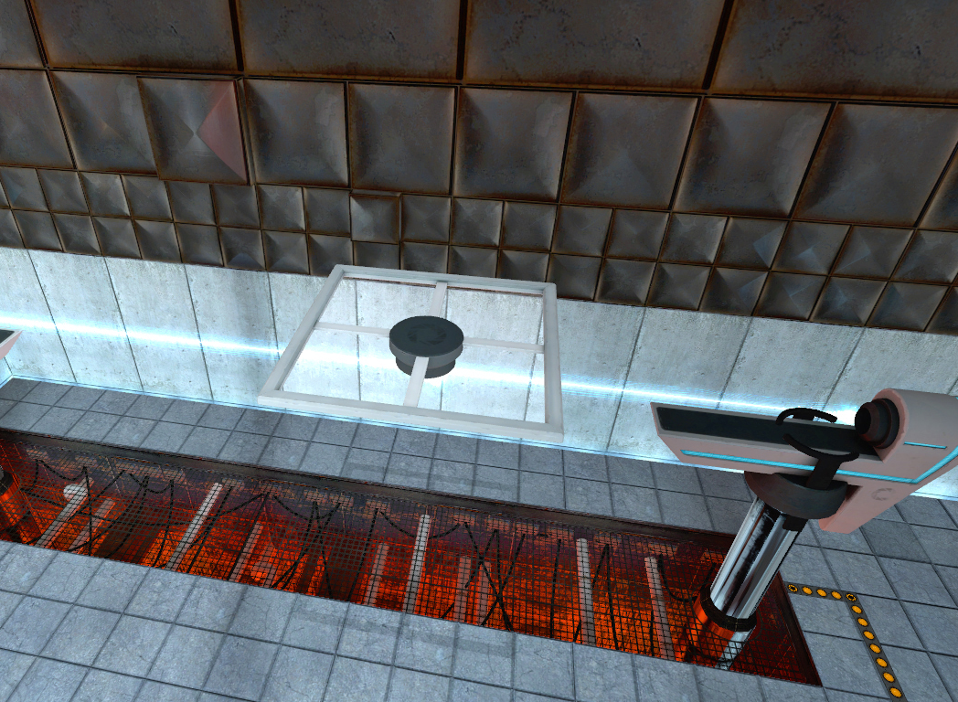
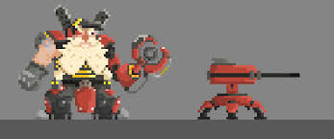
What’s Next?
Notes:
Moving platform and survival game in a Sci-Fi factory.
Defend the core of the platform with the multifunctional vacuum gun.
Collect scraps falling on the ground and use them as resource.
You can also build or repair turrets with the screwdriver head.

Slide 8
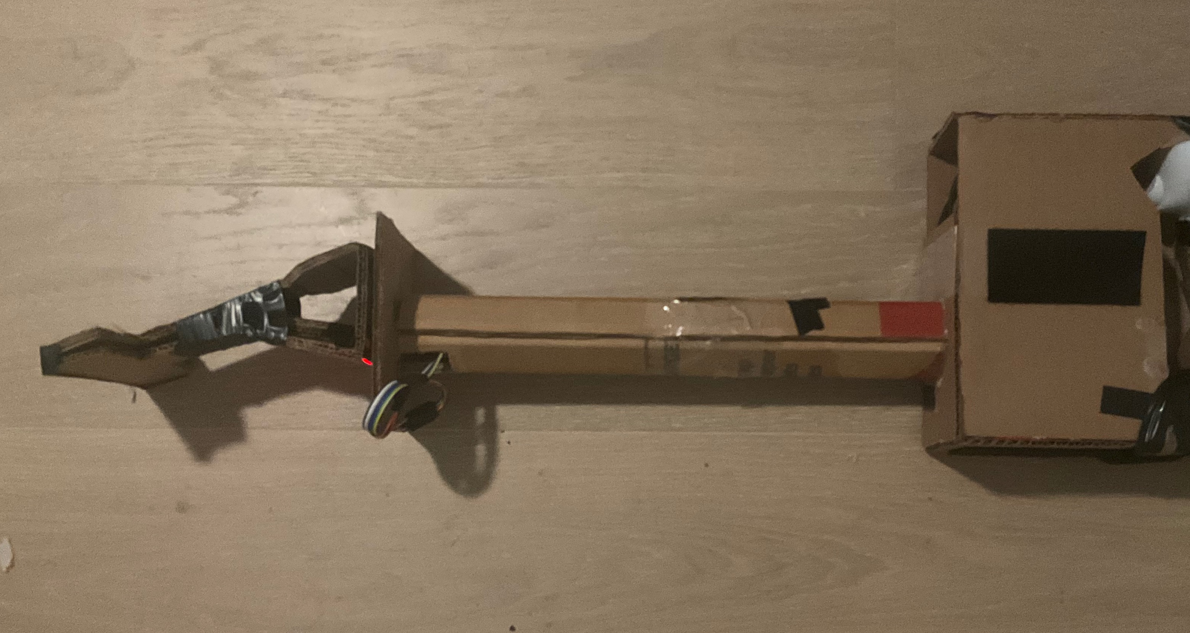
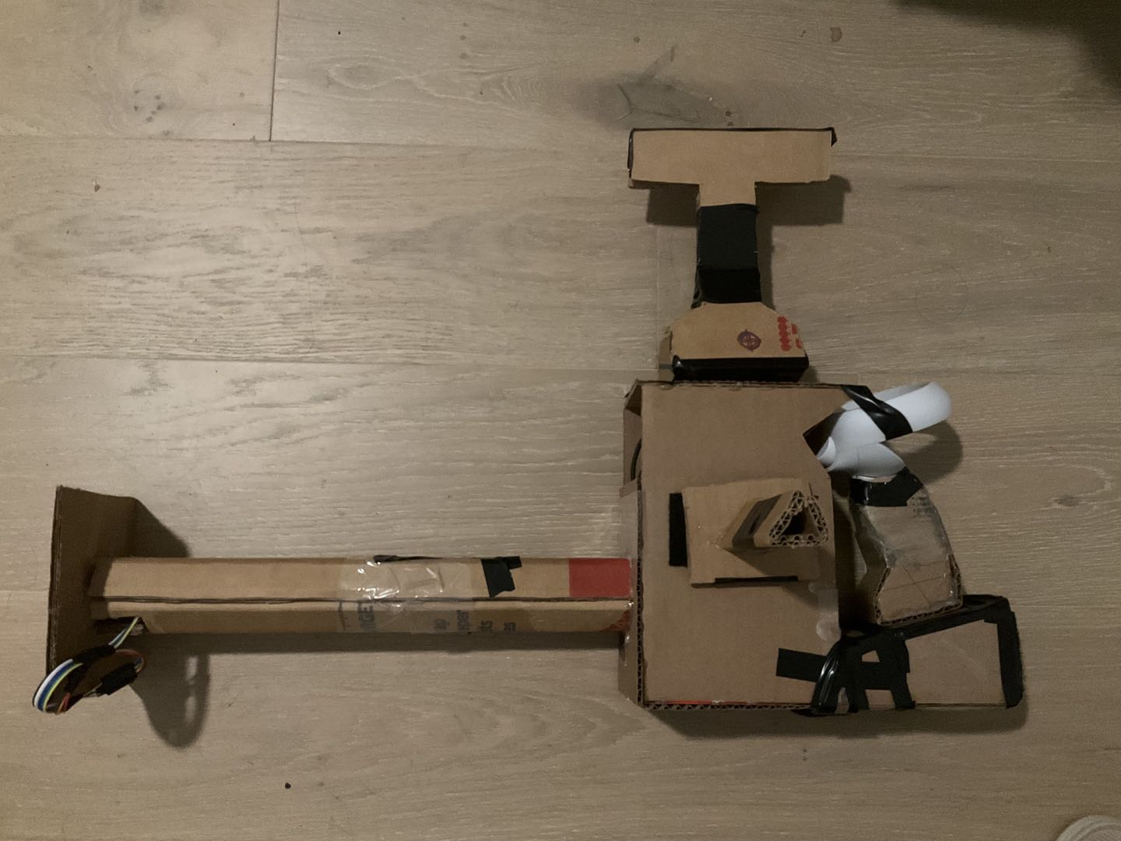
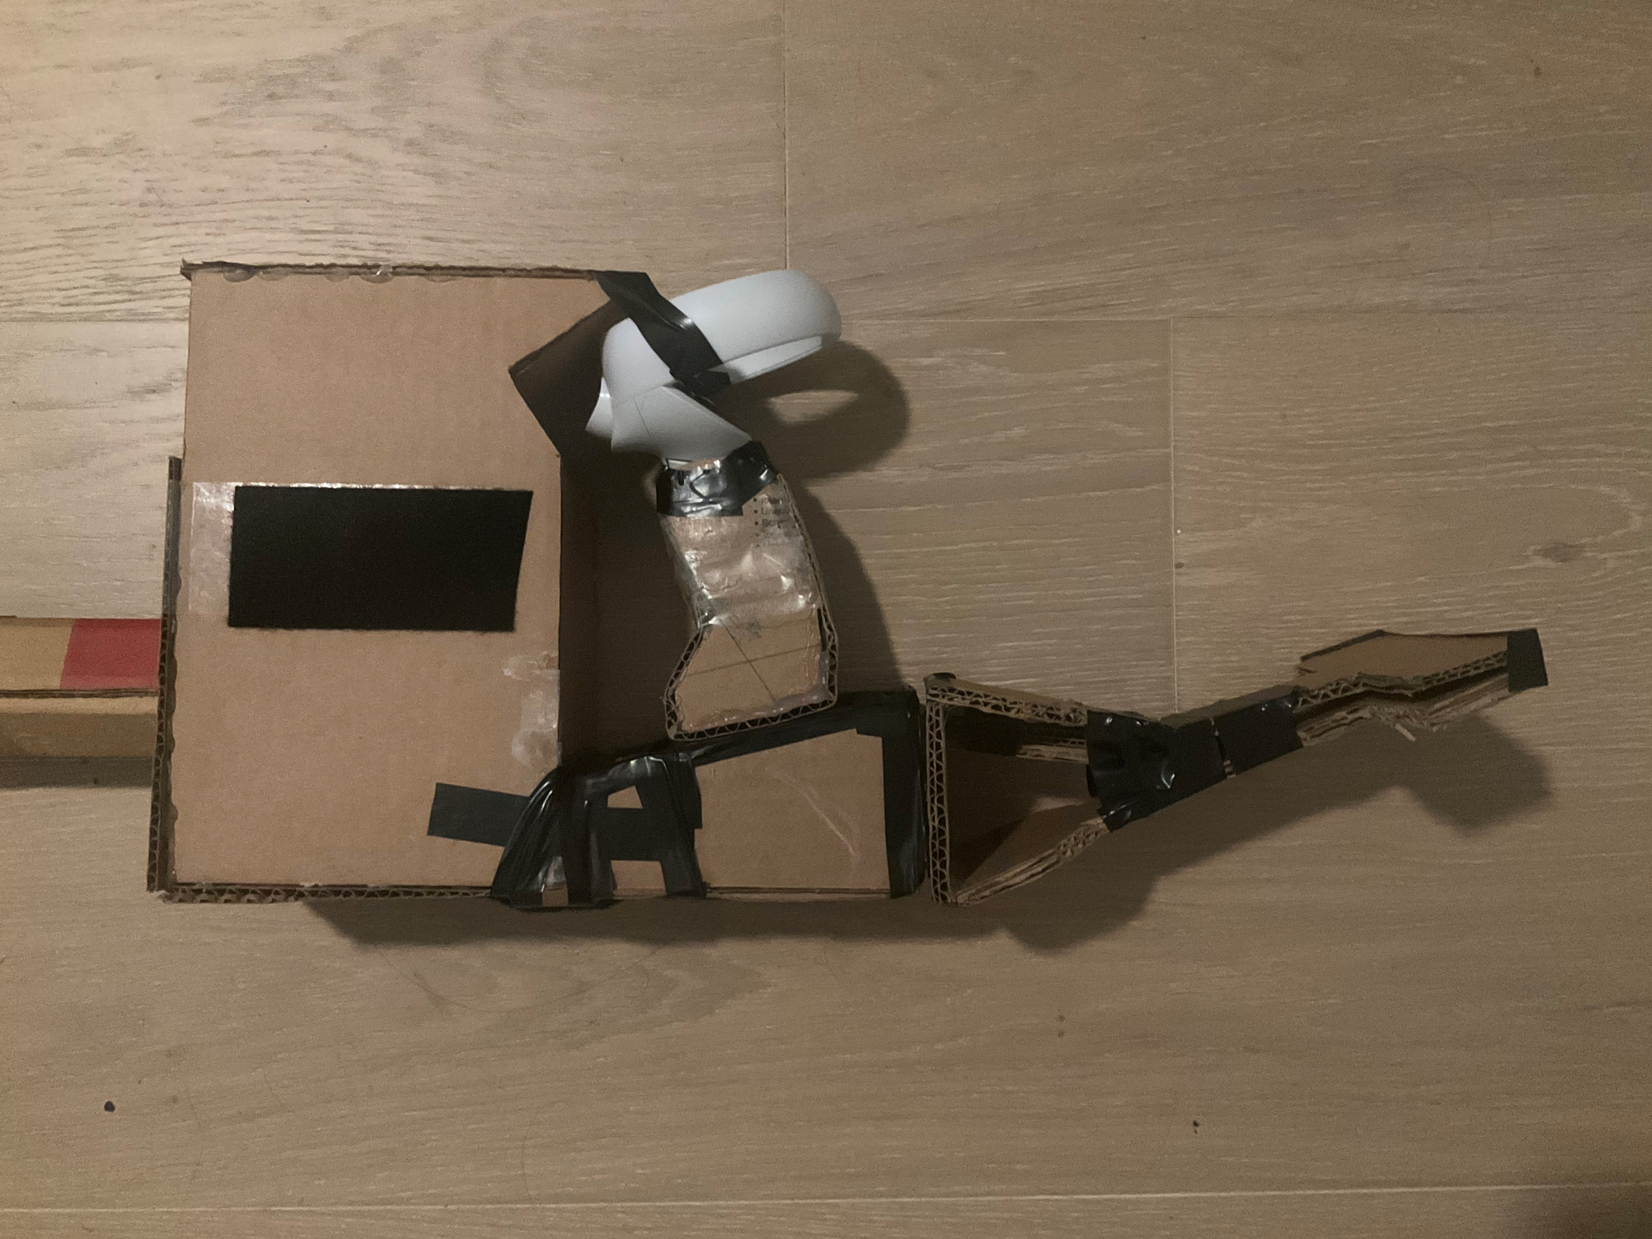
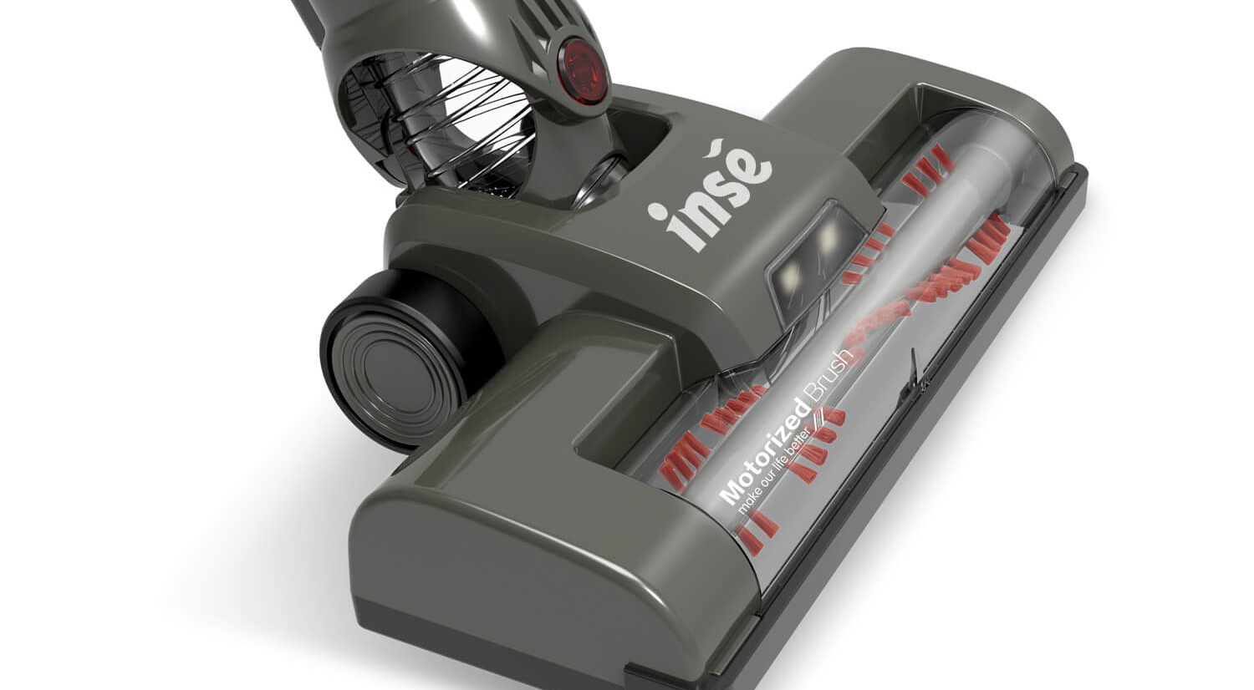
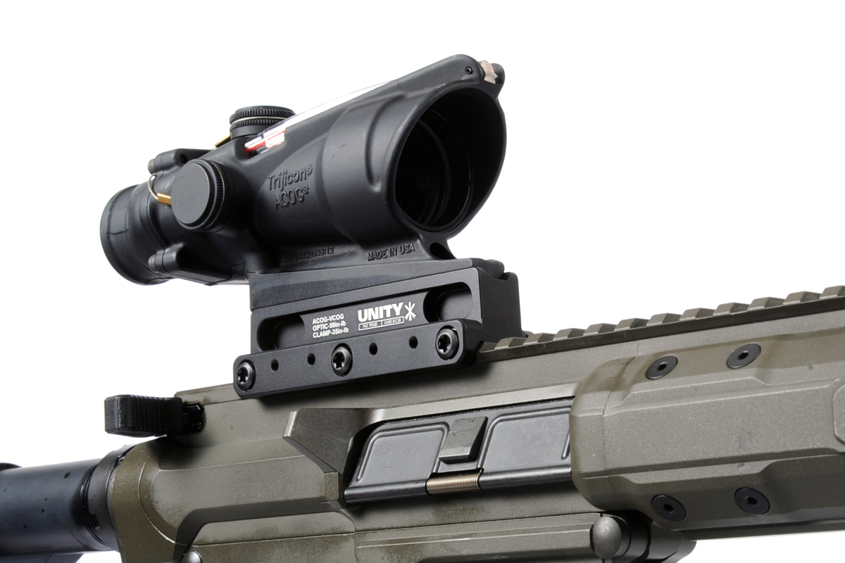
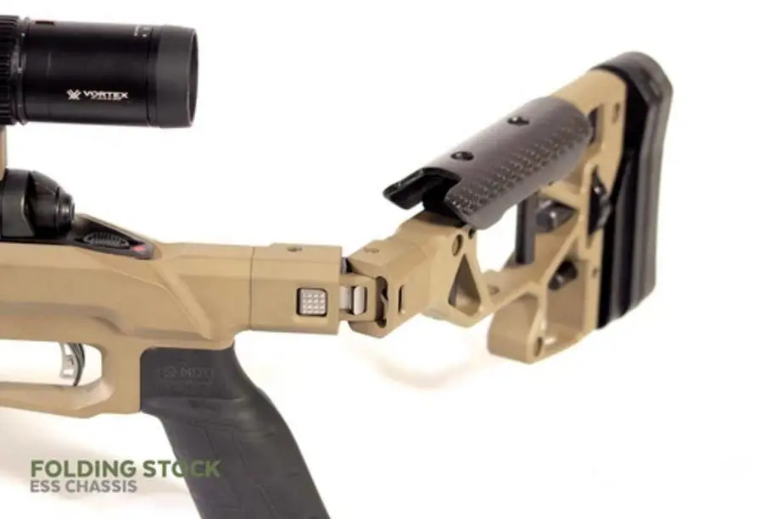
What’s Next?
Notes:
More Heads
Same heads on different socket can be used in different way.
Vacuum head – front = vacuum / Top = scope sight / end = stock

Slide 9
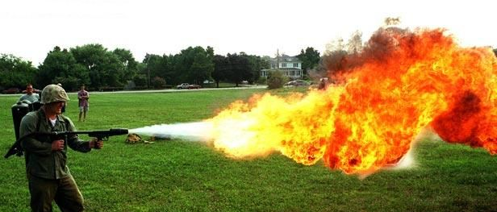
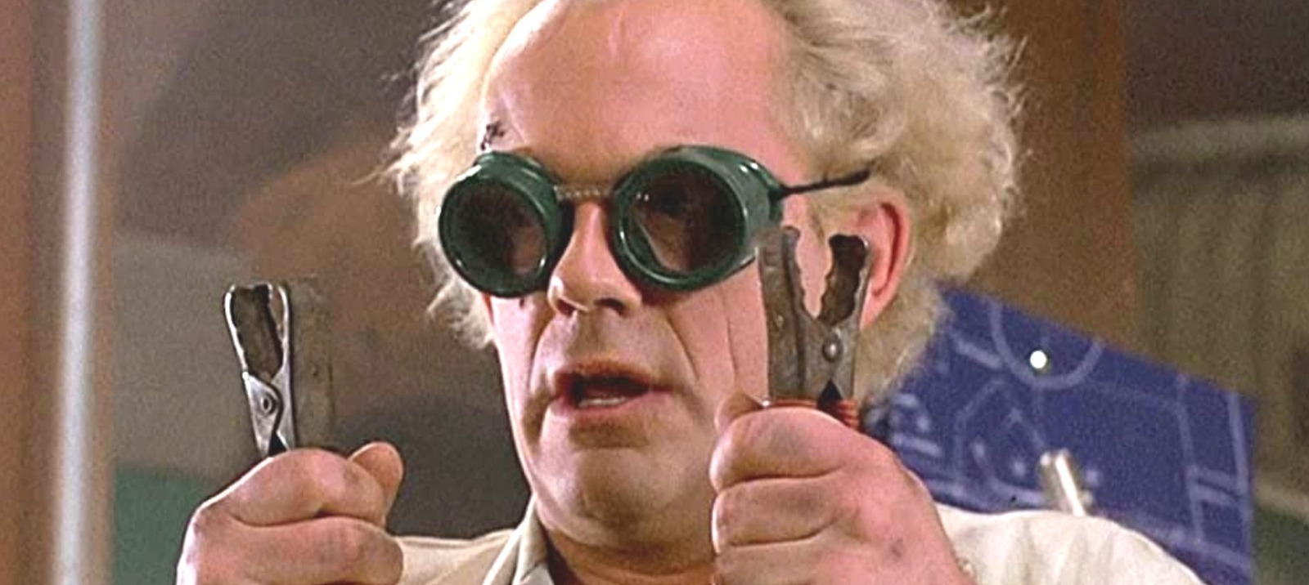
MORE POSSIBILITIES
Notes:
Open to more ideas

Slide 10
We need you!
Engineer (Virtual Reality / Gameplay / AI)
3D Artist (Character / Animation / Environment)
Game Designer (General / Virtual Reality)

